Slide 1
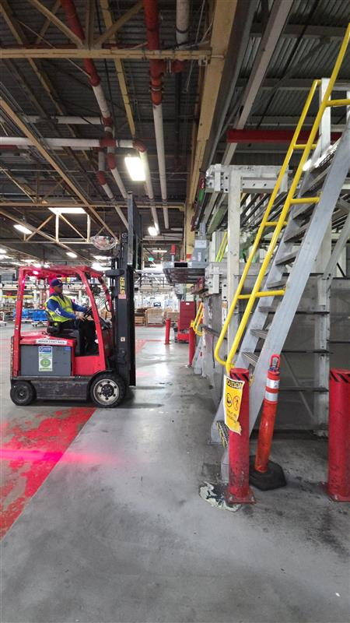
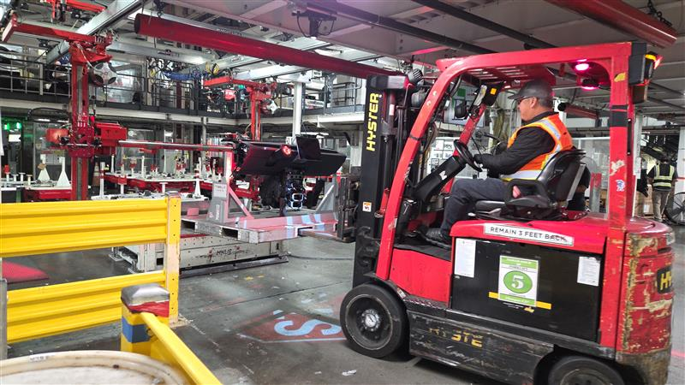
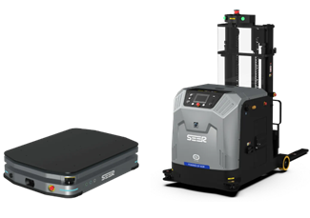
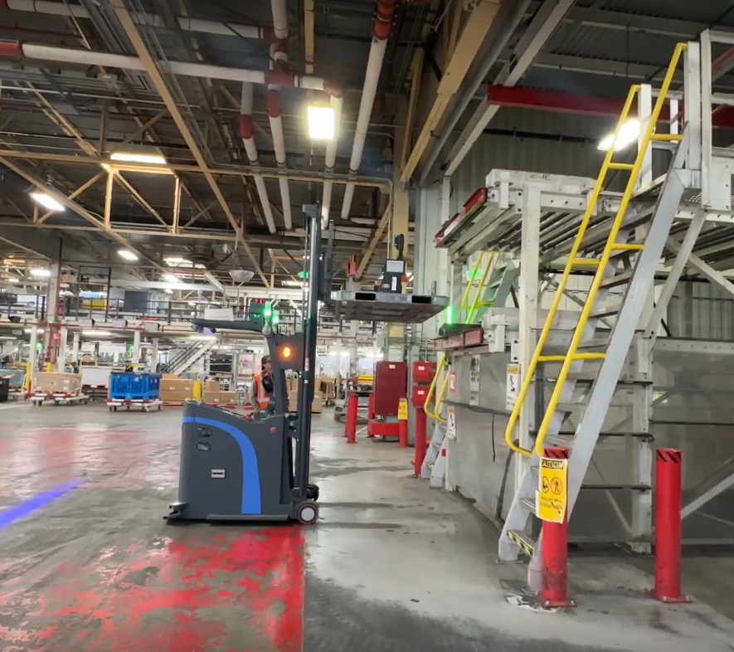
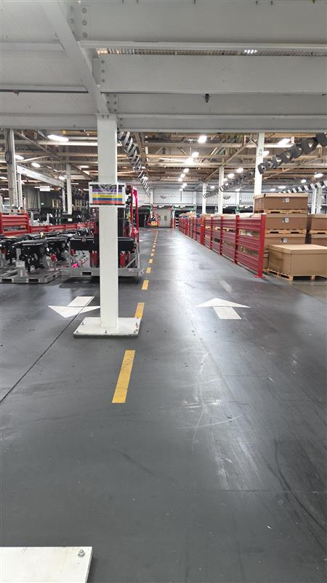
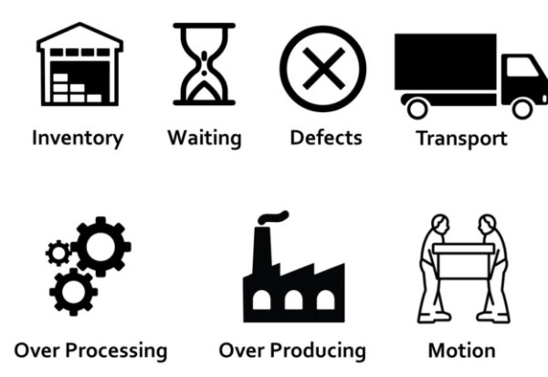
SHOP: Model-3 General Assy –GA-3-Project Name: Automated IP Conveyance to GA-Lineside
Status: In Progress
BEFORE
AFTER
Objective
To automate the manual transport of IP racks from Dock conveyor to GA line by reducing PIVs and headcount
Benefits
15 Headcount Reduction (4 per shift).
Elimination of 4 Forklifts at GA-3
Projected Annual Recurring Savings: $1,500,000 ($ 1.5 M)
Actions | Owner | Due | Status
Robot Movement | Shriman /Maaz | 17/05 | Completed
SLAM initialization and mapping | Shriman /Maaz | 19/05 | Completed
Pallet Recognition | Shriman /Maaz | 01/06 | Completed
Network Connectivity | Shriman /Maaz | 03/06 | Completed
Pallet Shuffle operation | Shriman /Maaz | 22/06 | Completed
Process Identification & Planning | Maaz/PC Process | 25/07 | Completed
Number of Robots' calculation | Maaz /PC process | 15/08 | Completed
Management Approval | Fremont Management | 15/09 | Completed
Leadership Approval | Tesla Leadership |  | Pending
Wastes Eliminated
Notes:
The motive of the entire project is to move the instrument panel of the model-3 car from the Dock conveyor .... All the way into the transfer stand at GA side below the mezzanine which is then put on the AGVs to transfer it to GA line. The current operation uses 4 forklifts or sometimes 5 to 6 depending on the UPH the line is running in and these causes line performance losses due material availability , also we all know the risk of operating forklifts in human interaction zones, and it leads to lot of near miss incidents and finally ,the current setup can cater only 45 to 50 UPH while the GA line requirement is 55 UPH as per the factory design.
To solve those problem , we ideated a solution to use mobile robots to transport the IP pallets from the dock conveyor to the GA side for which we have planned to get 6 Forklift AMRs and 10 Smaller lifter AMR to achieve the line design capacity. These robots are equipped with Lidar scanners for mapping the environment and laser scanners to scan for human presence and other obstacles and navigate around it as well.
As you can see in the CAD layout , the RCI is the dock conveyor from where the forklift robot picks up the IP pallet and then it has to take it all the way to the GA side , where we have line following AGVs waiting for the IP to take it to the GA lineside.

Slide 2
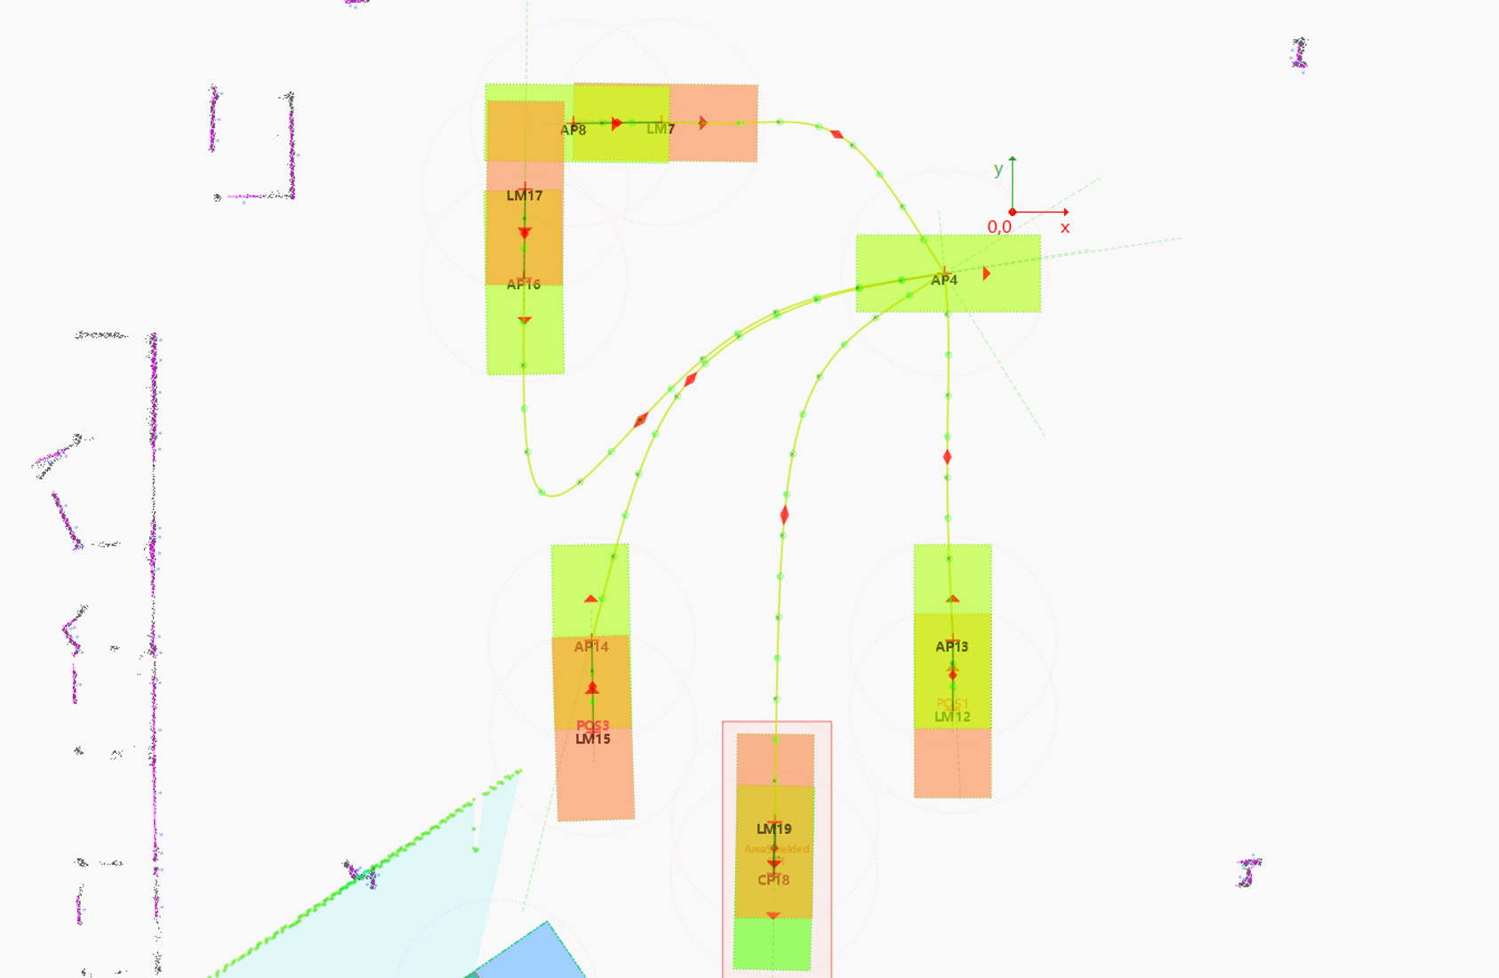
SHOP: Model-3 General Assy. Project Name: Automated IP Conveyance to GA-Lineside
Status: In Progress
Pallet Shuffle Operation Point A → Home
Home → Point B
Point B → Home
Home → Point A
Instrument Panel Rack pallet lifting trials
Notes:
PAUSE & EXPLAIN :
Here we are going a pallet lift and drop operation performed by the robot in the way represented in the map in the right ,
The robot has already picked up the pallet from Point A and is moving towards Home position .
From Home , it going to go to Point B ,where its going to go and drop the pallet and go to home position
Then it's coming back again to point B and recognize the pallet pockets for a moment , and then goes into the pallet to pick it up and come back to home position
Then again , it going back to Point A to drop the pallet and there we go !
This is one of the demonstrations that we tested in the factory , we had other areas like Model Y IP transfer , Overmind testing area , Busbar Line , Model SX rack transfer where we tested this robot’s versatility .

Slide 3

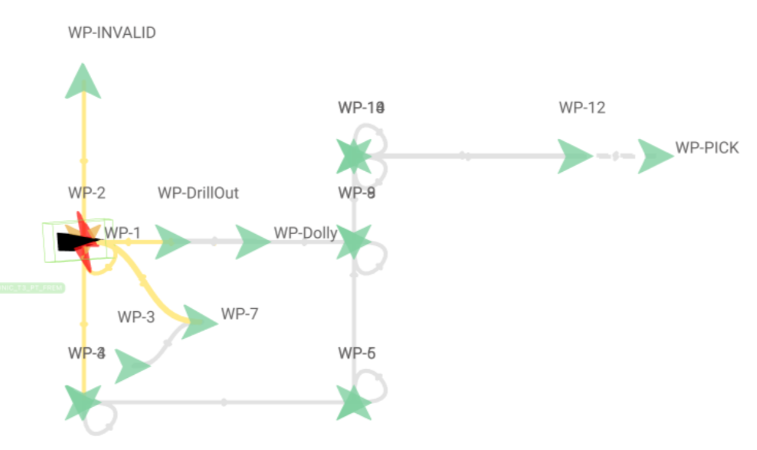
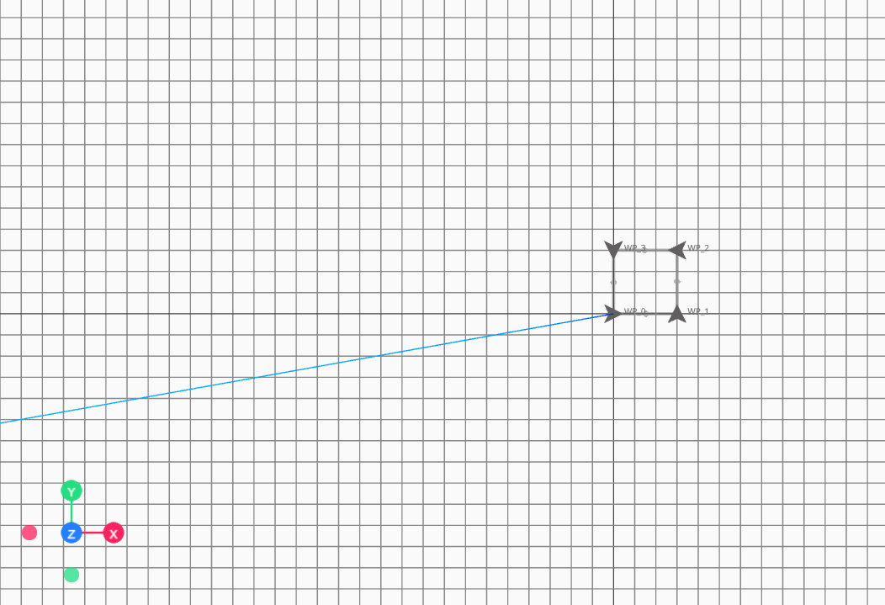
SHOP: TSLA Project Name: Project Moonwalk –Automated Path Planning for Overmind
Status: Completed
BEFORE
AFTER
Objective
To automate the path planning between robotic waypoints, reduce time for motion planning, and integrate real world lidar mapping
Benefits
Faster material flow planning and robotic deployment
Error prevention through Real world map interaction.
Reduction of Time complexity by 83% - 1.2s → 0.2s
Actions | Owner | Due | Status
Project Feasibility | Shriman | 06/10 | Completed
Map conversion and plotting | Shriman | 06/15 | Completed
Noise Removal | Shriman | 06/22 | Completed
Obstacle Aware automated Path planning | Shriman | 07/05 | Completed
Path Export for Robot operation | Shriman | 07/15 | Completed
POC testing & Demo | Shriman | 07/25 | Completed
Overmind Integration | Overmind team | 09/10 | Completed
Wastes Eliminated
Notes:
Now that you have seen how the robot hardware interacts with the factory environment , it is important to investigate the other essential , the software part.
Are you guys familiar with what is Overmind ??
When I first got acquainted with Tesla’s Overmind , I used to wonder why are these system manual when we could automate the entire path planning workflow , the current system , lacks this which slows the setup times and requires manual intervention . Also , the current mapping setup didn’t have any real-world map integration which would actually give us the view of where do we want the robot to move.

Slide 4
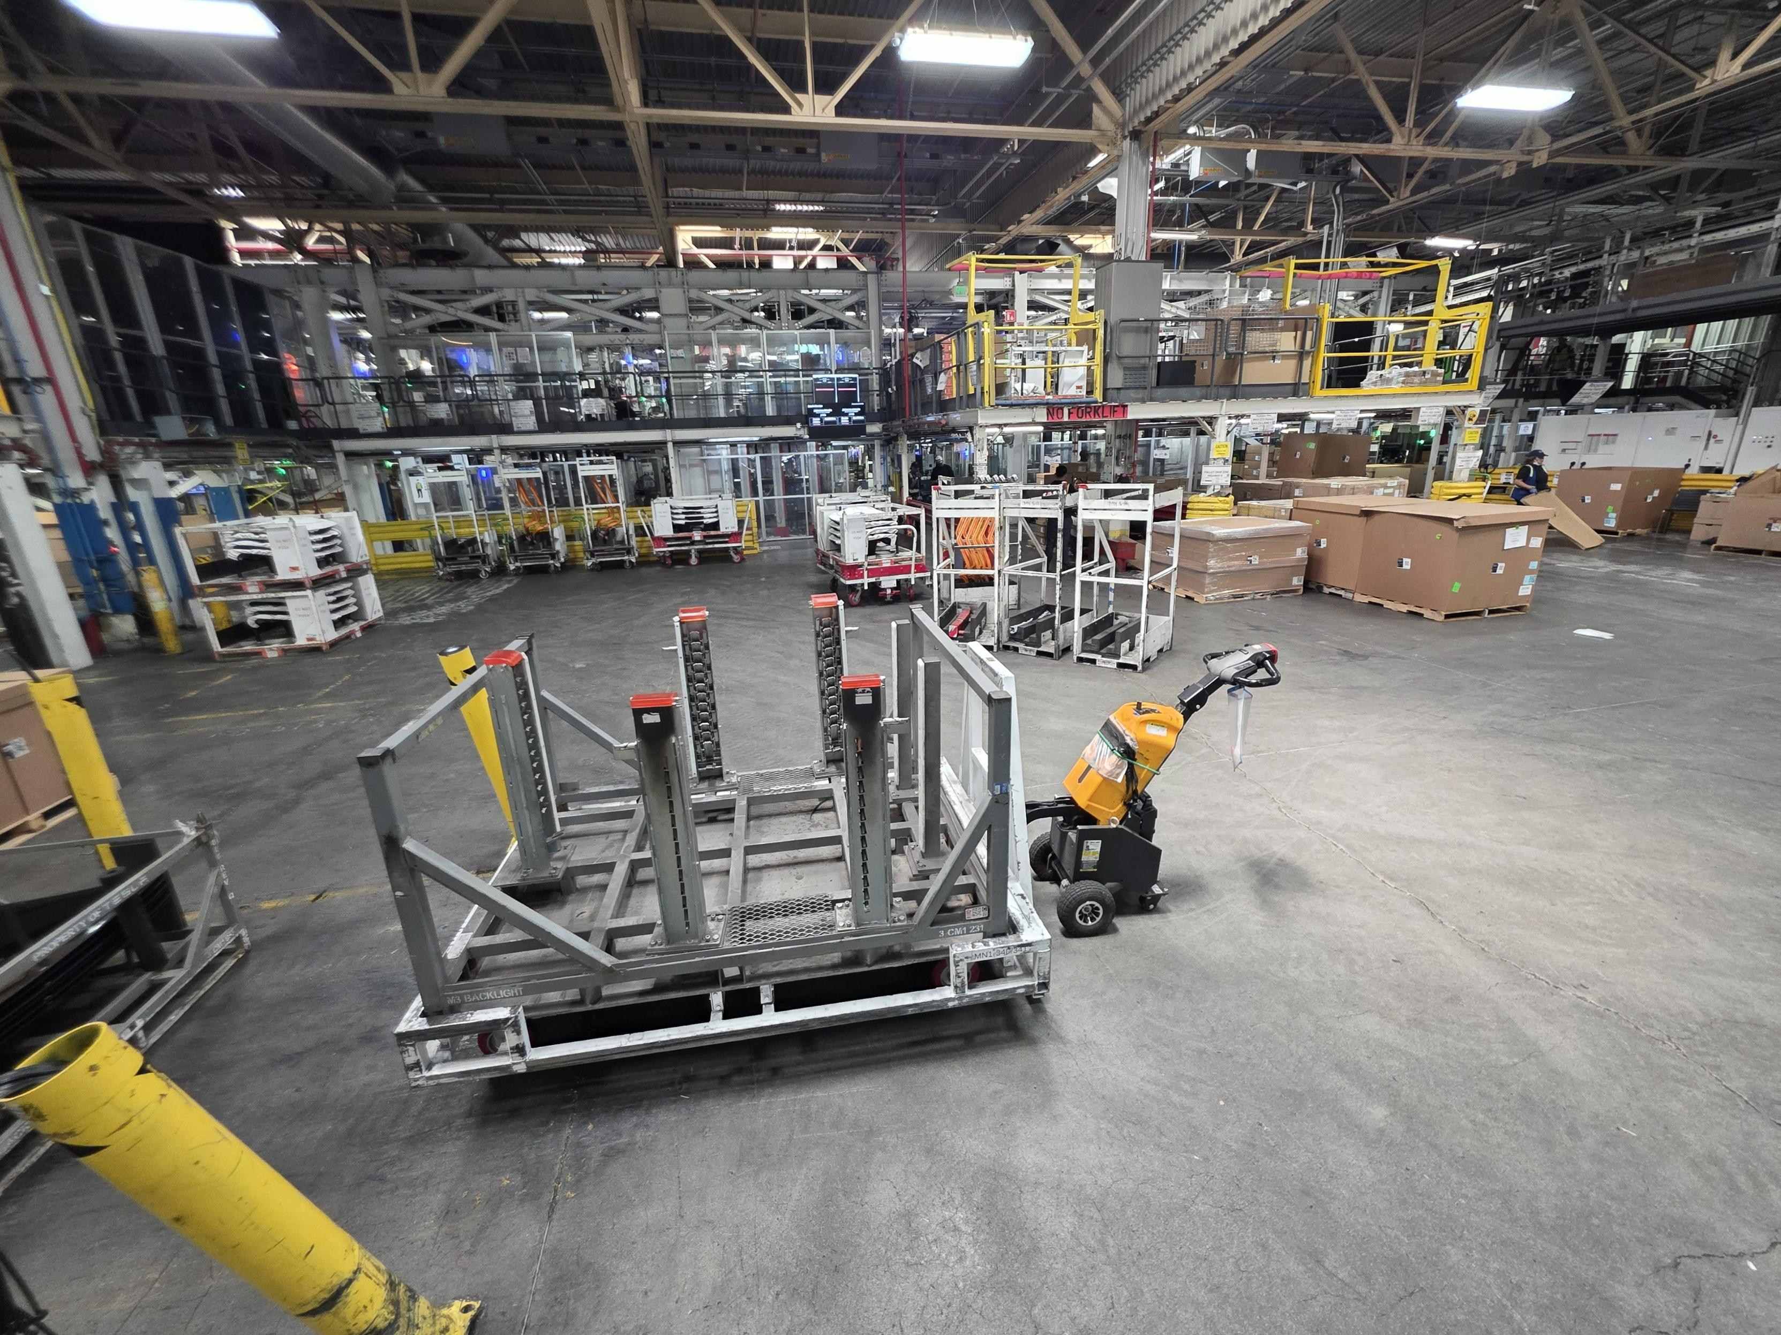
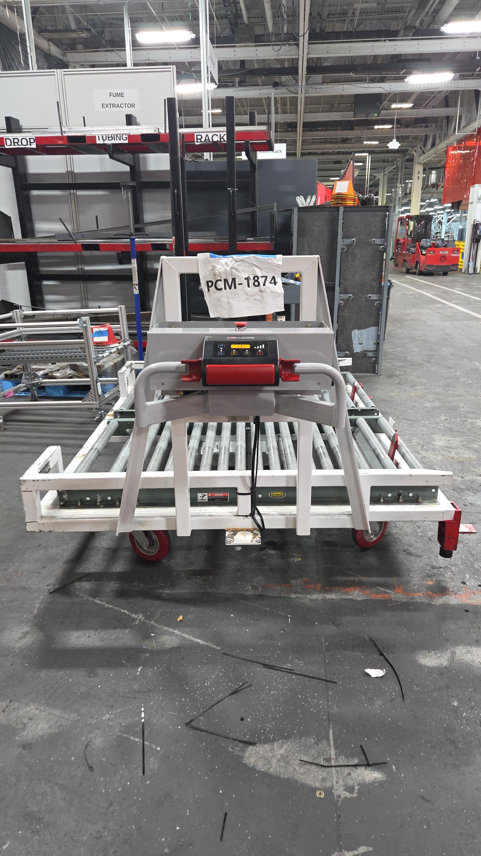
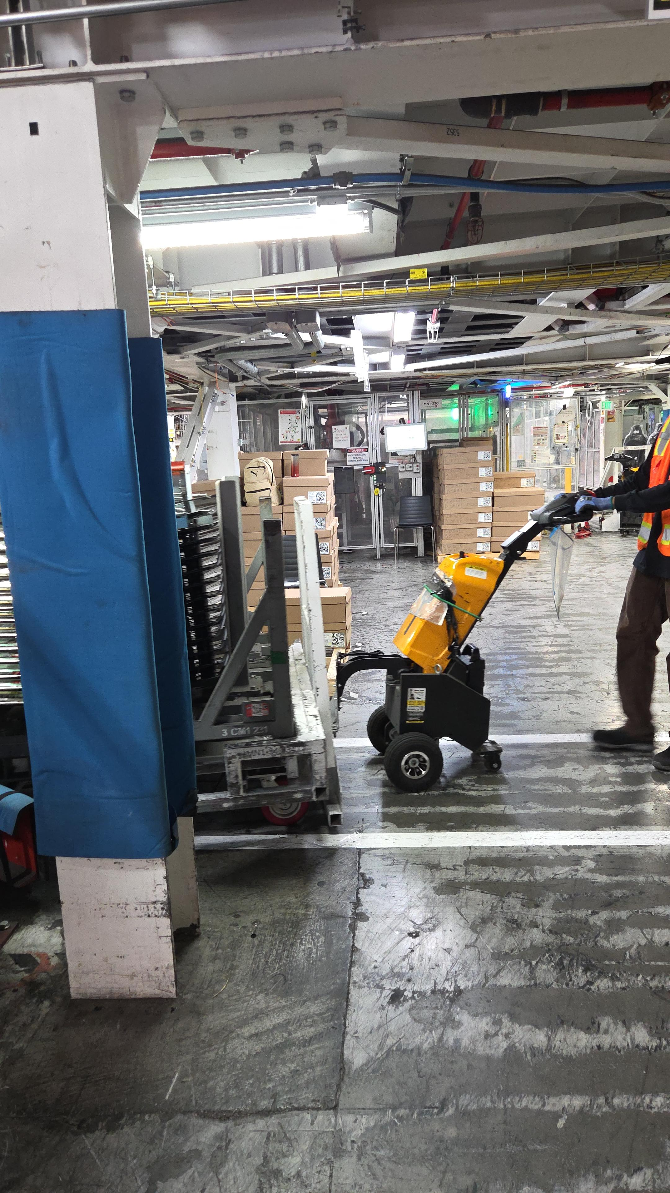
SHOP: Model-3- GA-3 Project Name: Powered Retractable Conveyance System
Status: In Progress
BEFORE
AFTER
Objective
To facilitate late mile dolly delivery of higher load dollies in tugger routes to lineside.
Current delivery system has limited maneuverability and higher chances of user fatigue
Benefits
Reduced user fatigue and efficient material flow design for remote lineside access.
Elimination of NVAAs of tow hitching which unlocks future scalabilities for heavier dolly routes
Actions | Owner | Due | Status
Concept Study | Joey | 10/15/24 | Completed
Design validation | Joey/ Vendor | 03/15 | Completed
Installation of powered Caster wheel | Shri/Joey | 06/06 | Completed
Functional Testing | Shri/Joey | 06/15 | Completed
First article development | Shri/ Joey |  | Ongoing
Wastes Eliminated

Slide 5
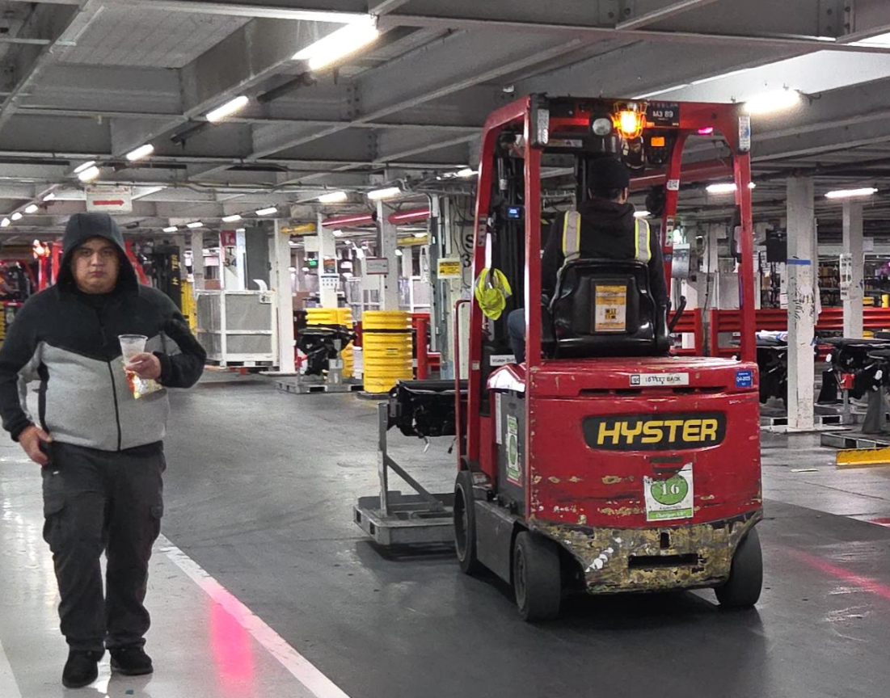
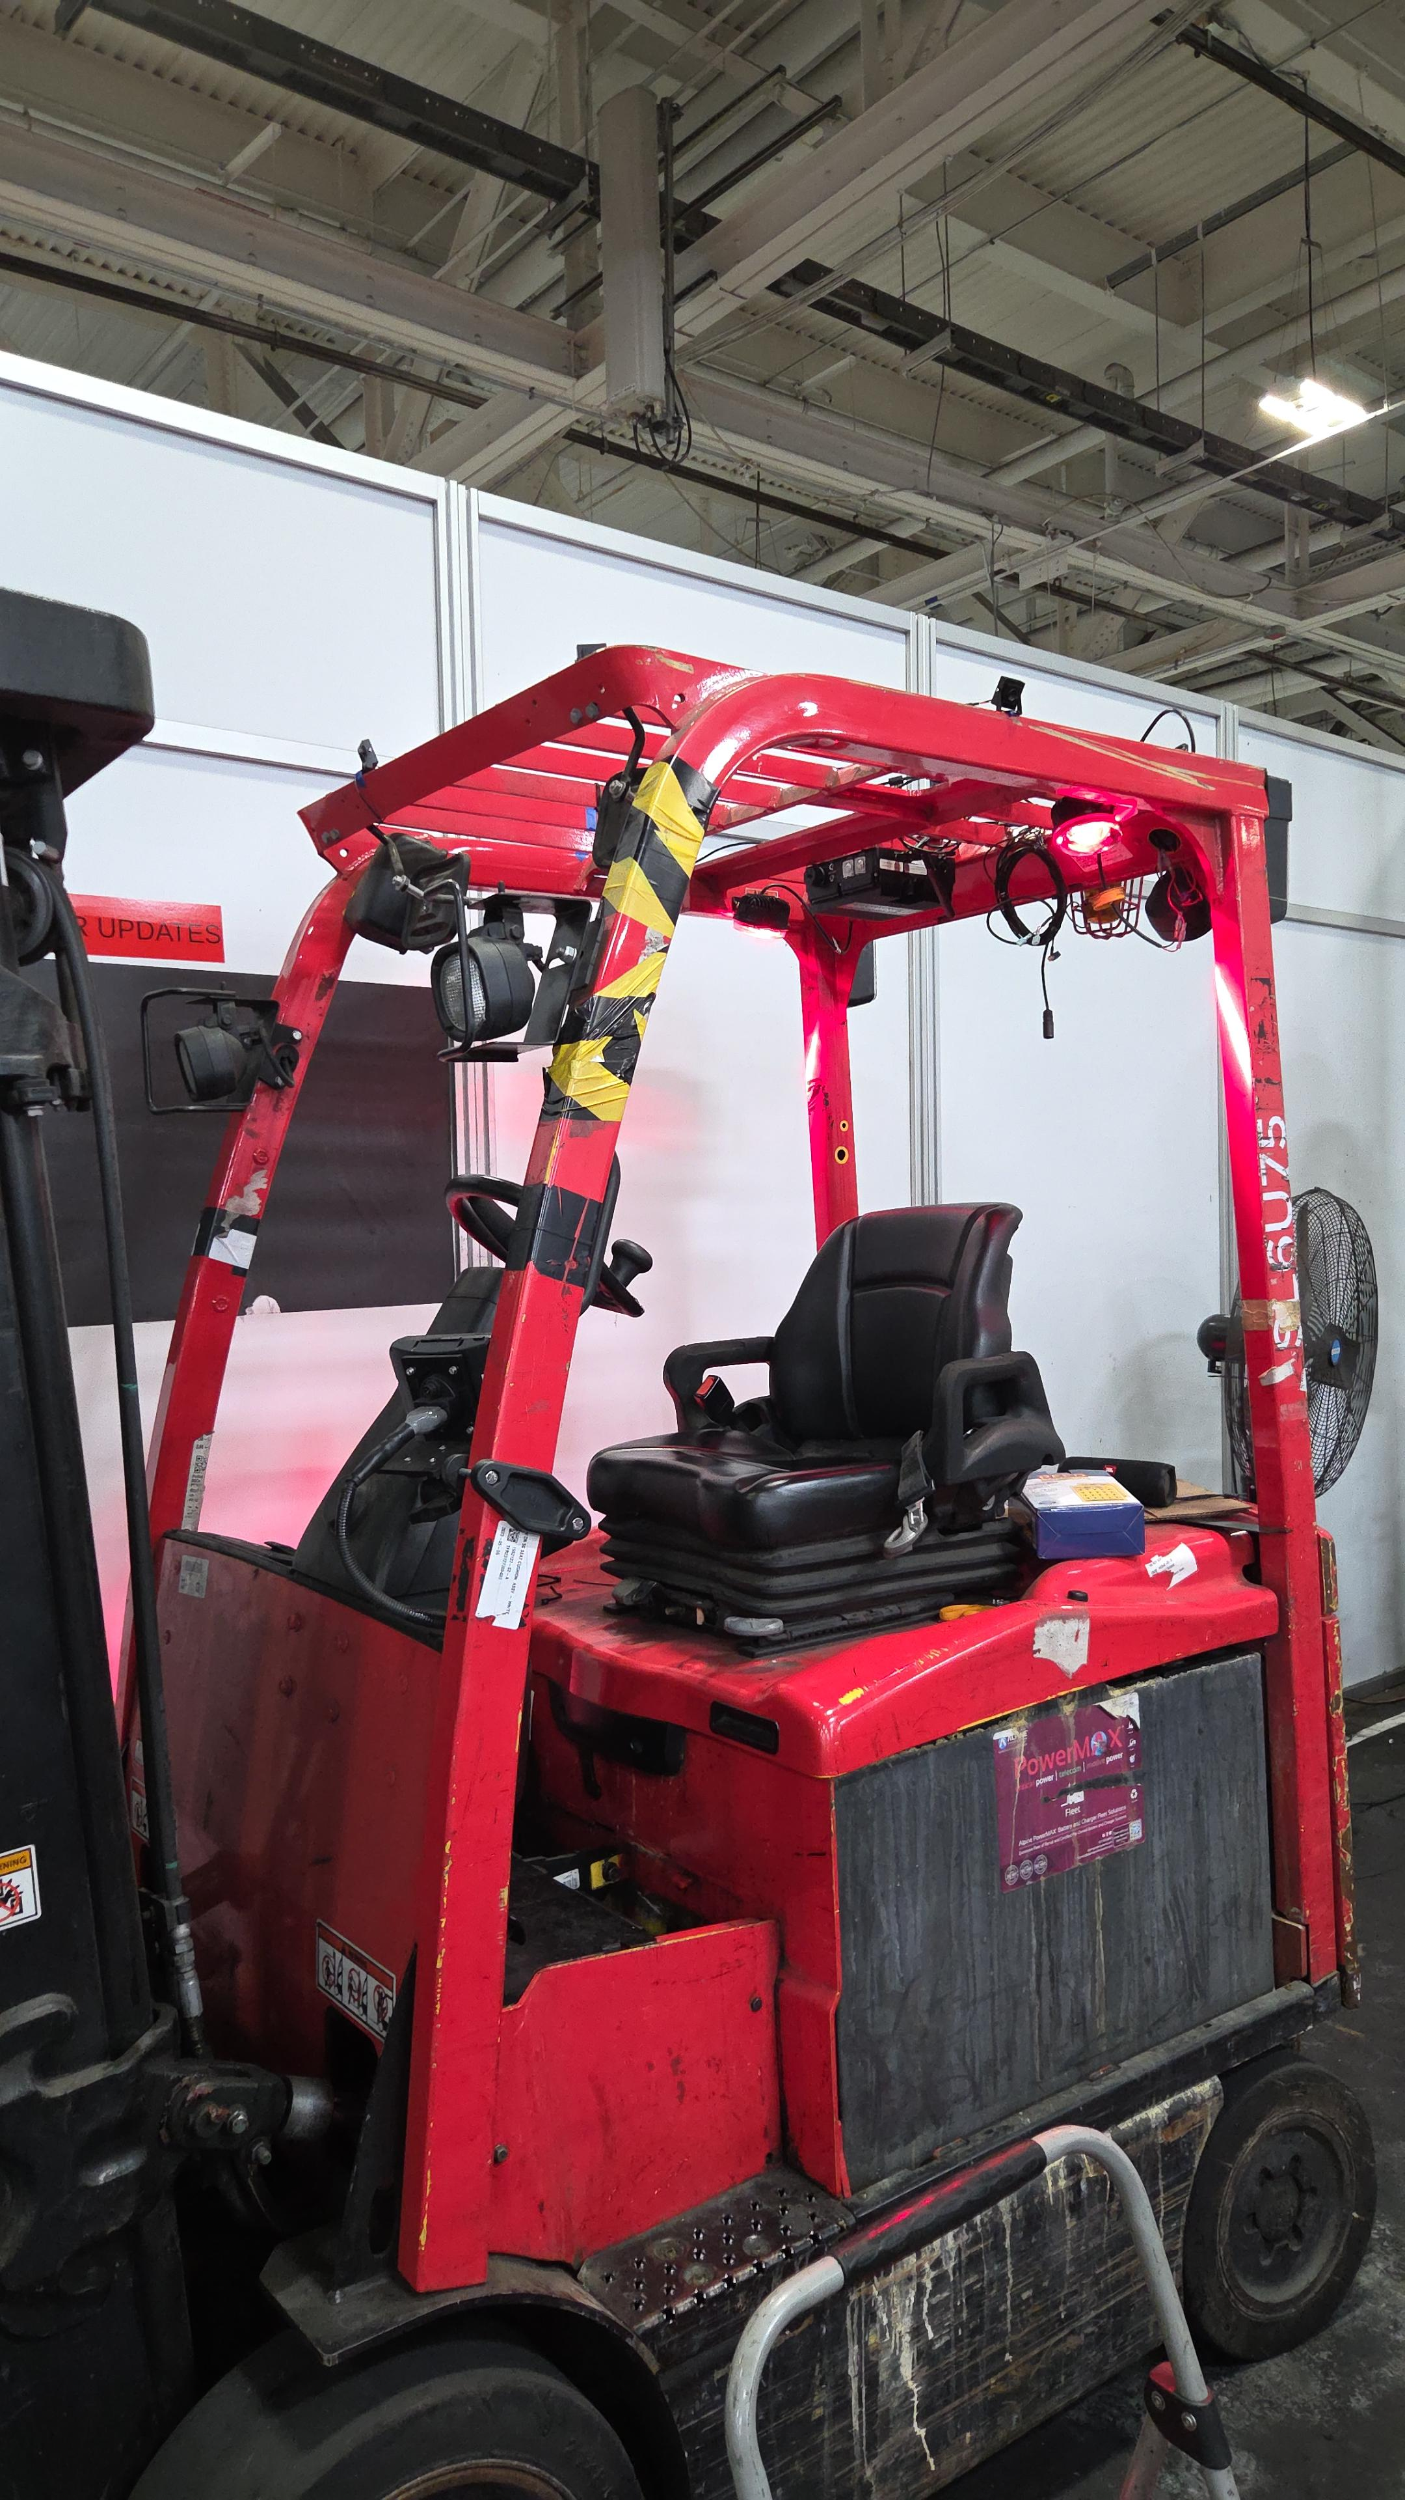
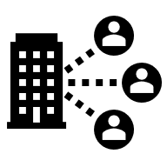





SHOP: Across Tesla Project Name: In house Pedestrian Detection System – Project S.E.N.T.I.N.E.L
Safety Enhanced Neural Tracking for Industrial Navigation & Environment Learning
Status: In Progress
BEFORE
AFTER
Difficulty in spatial awareness while driving the forklift
Forklift installation
Objective
To design, program and implement a low-cost high impact pedestrian detection and warning system to be installed on PIVs
Benefits
Complete stand-alone solution that can be installed on all PIVs provide immediate increase in operator safety in the factory.
Control over both hardware and software layers for future improvements.
Actions | Owner | Due | Status
Feasibility Study | Shriman | 10/01 | Completed
Concept Review | Shriman | 10/05 | Completed
Dev & programming | Shriman | 10/31 | Completed
BOM design & Procurement | PC Fixed Equipment | 11/05 | Completed
First Article testing | Shriman | 12/01 | Ongoing
Fleet expansion | Shriman |  | Pending
PQCDMS
Productivity
Quality
Cost
Delivery
Safety
Morale

Slide 6
SHOP: PC GASX –All Models Project Name: Flux AI Document Integration
Status: Completed
BEFORE
AFTER
Objective
To integrate documents of engineering assets with Flux AI to help in troubleshooting processes
Benefits
Enhanced troubleshooting with the support of RAG based document referencing.
Faster onboarding and deployment of newer maintenance associates
Actions | Owner | Due | Status
Feasibility Study | Shriman | 05/16 | Completed
Concept Review | Shriman /Shawn/IT-Flux team | 05/23 | Completed
POC validation | Shriman | 06/06 | Completed
Buy off | IT-Flux team | 07/04 | Completed
First trail implementation | IT-Flux team | 07/11 | Completed
Production testing | PC Equipment Engg | 08/15 | Completed
Handoff | Shriman | 09/15 | Completed
PQCDMS
Productivity
Quality
Cost
Delivery
Safety
Morale

Slide 7
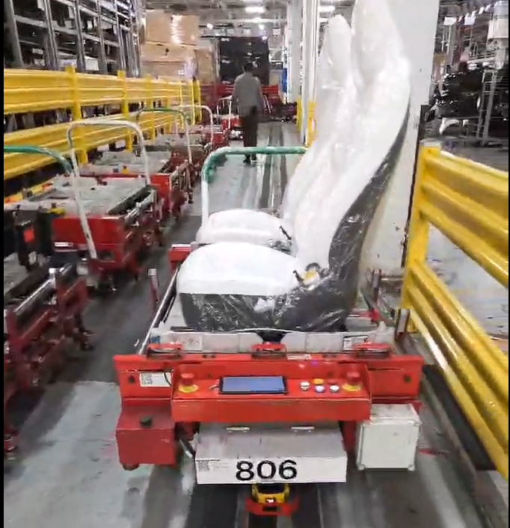
SHOP: Model-3 General Assy.-GA-3 Project Name: Seats AGV Design Optimizations
Status: Completed
Objective
The Problem
Design optimizations of existing AGV
Reduction in cost of maintenance
Improve delivery process
Solution
DFMEA-Design Failure Mode Effects & Analysis
Top Failure Modes Identified
Forced Vibrations
Derailment from AGV paths
Communication discontinuity
Design
Focus on product design and functionality
Failure
Identification of possible failure types in the design
Mode &
Analysis of how a failure occur or appear
Analysis
Effect
Evaluation of consequences of that failure
Assessment to reduce the risk and prevent issues in future
Mechanical subsystems
Electrical subsystems
Notes:
Now that you have seen how the robot hardware interacts with the factory environment , it is important to investigate the other essential , the software part.
When I first got acquainted with Tesla’s Overmind , I used to wonder why are these system manual when we could automate the entire path planning workflow , the current system , lacks this which slows the setup times and requires manual intervention . Also , the current mapping setup didn’t have any real-world map integration which would actually give us the view of where do we want the robot to move.

Slide 8
SHOP: Model-3 General Assy.-GA-3 Project Name: Seats AGV Design Optimizations
Status: In Progress
Solution
Dampening of Vibrations
Identification of Vibrational occurrences across AGV routes
Collection of vibrational data of AGVs running in the route and identifying spots of forced vibrations more than 200 Hz.
Correlating vibrations with spots on the map for location accuracy
Testing of softer AGV wheels to dampen vibrations
Comparing different softer wheels configurations and analyzing the vibrational impact reductions.
Identification and purchase of better wheel configuration with dampening and durability.
Development of tool to analyze and plot vibrations.
Notes:
Now that you have seen how the robot hardware interacts with the factory environment , it is important to investigate the other essential , the software part.
When I first got acquainted with Tesla’s Overmind , I used to wonder why are these system manual when we could automate the entire path planning workflow , the current system , lacks this which slows the setup times and requires manual intervention . Also , the current mapping setup didn’t have any real-world map integration which would actually give us the view of where do we want the robot to move.

Slide 9
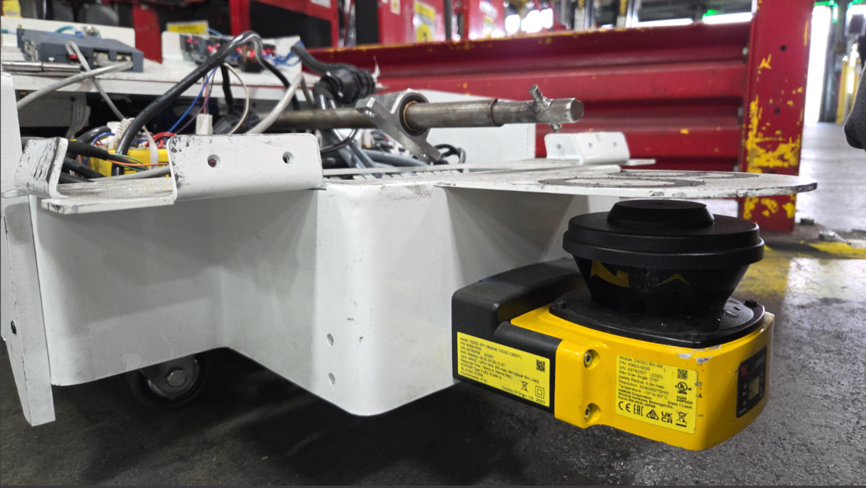
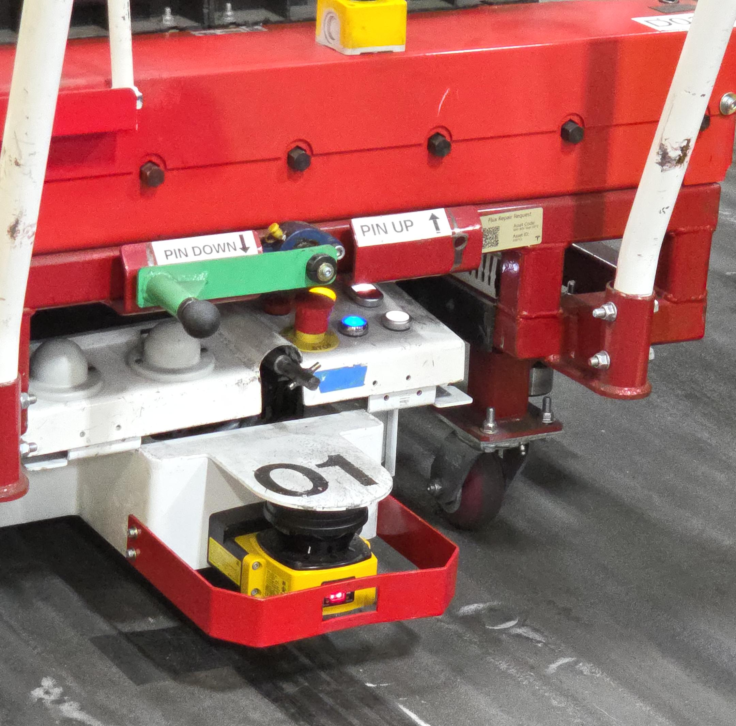
SHOP: Model-3- GA-3 Project Name: Laser Protection Bracket Design
Status: Completed
BEFORE
AFTER
Objective
To protect the laser sensor of the AGV from damage during collision and reduce maintenance cost
Benefits
Reduction in AGV downtime by preventing sensor damages , leading to recurring annual savings of $16,000.
Actions | Owner | Due | Status
Design study | Shriman | 05/16 | Completed
Concept Review | Shriman | 05/23 | Completed
First Article validation | Shriman /PC Fab shop | 06/06 | Completed
Buy off | PC Fixed Equipment | 07/04 | Completed
Fleet Expansion | Shriman/PC Fab shop | 07/11 | Completed
Production testing | Shriman /PC Fixed Equipment | 07/18 | Completed
Handoff | Shriman | 08/05 | Completed
Wastes Eliminated

Slide 10
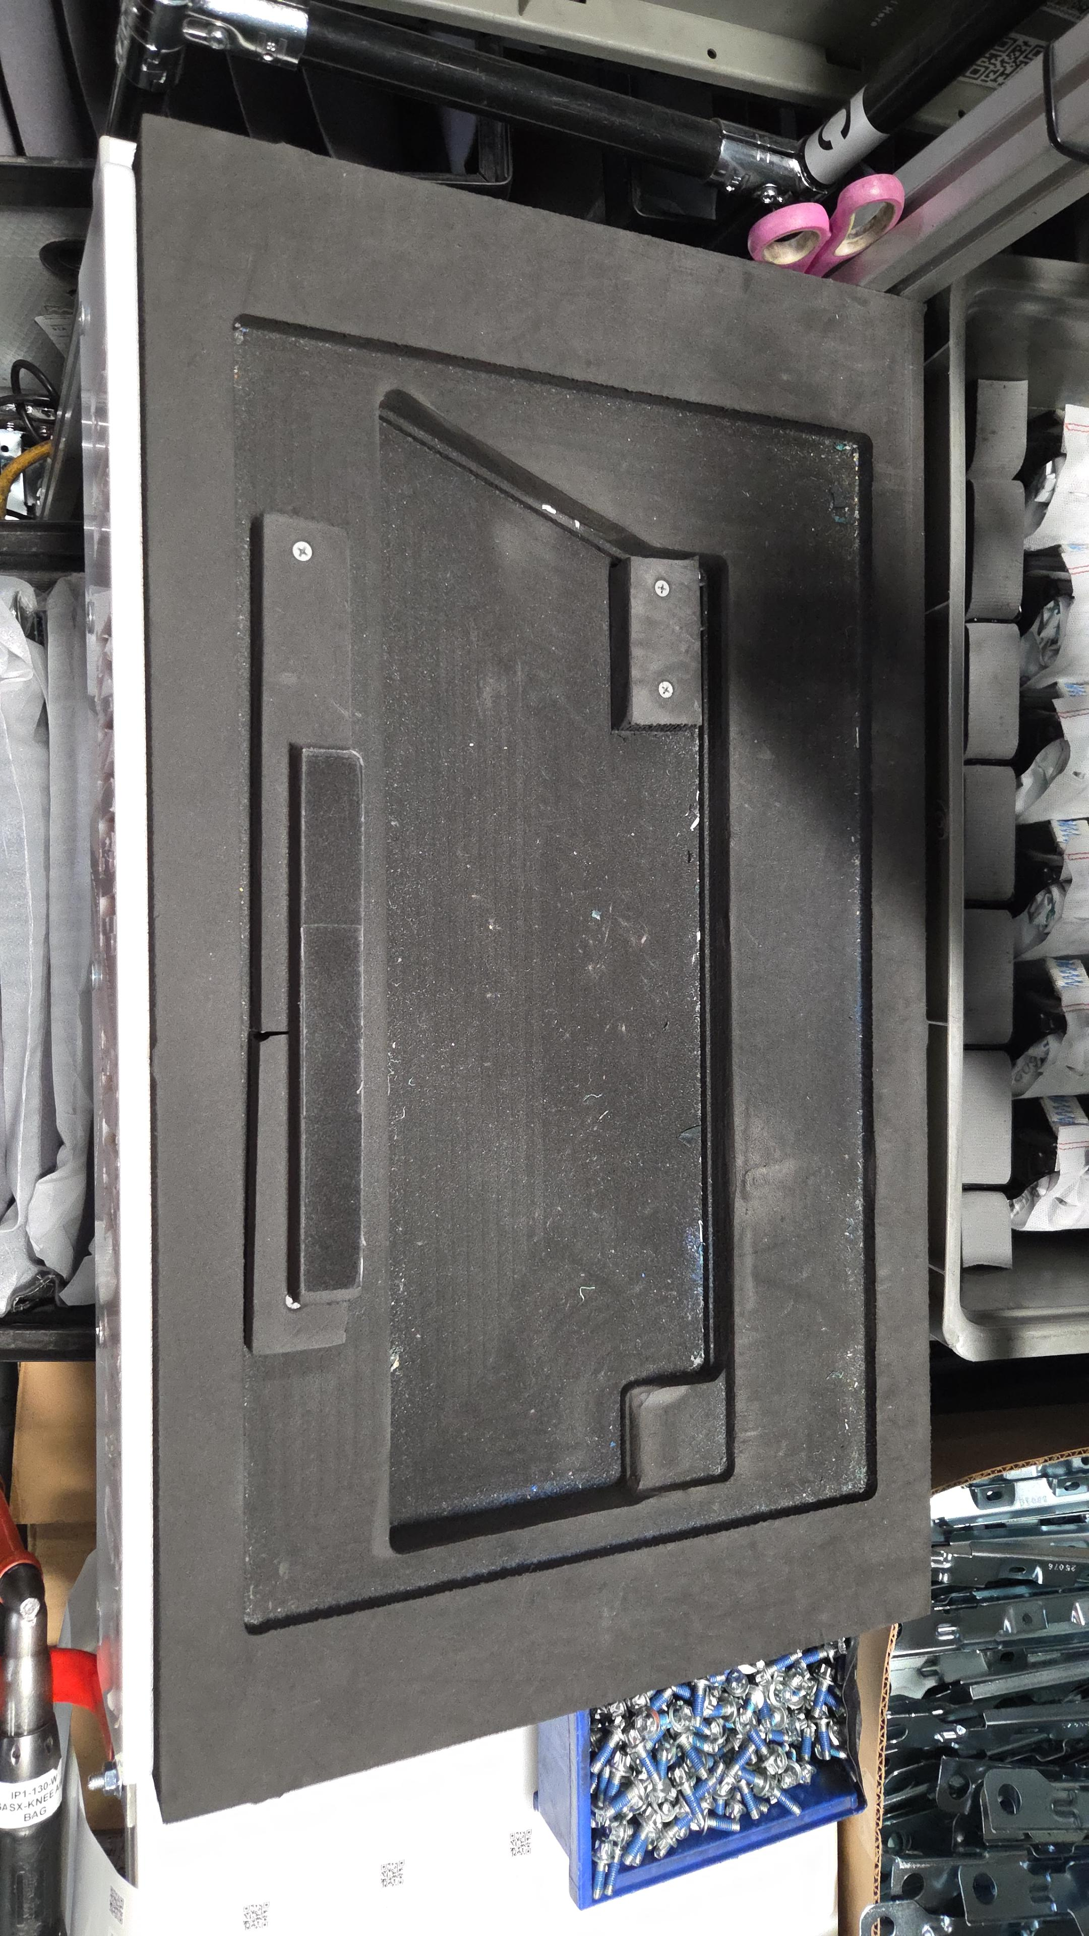
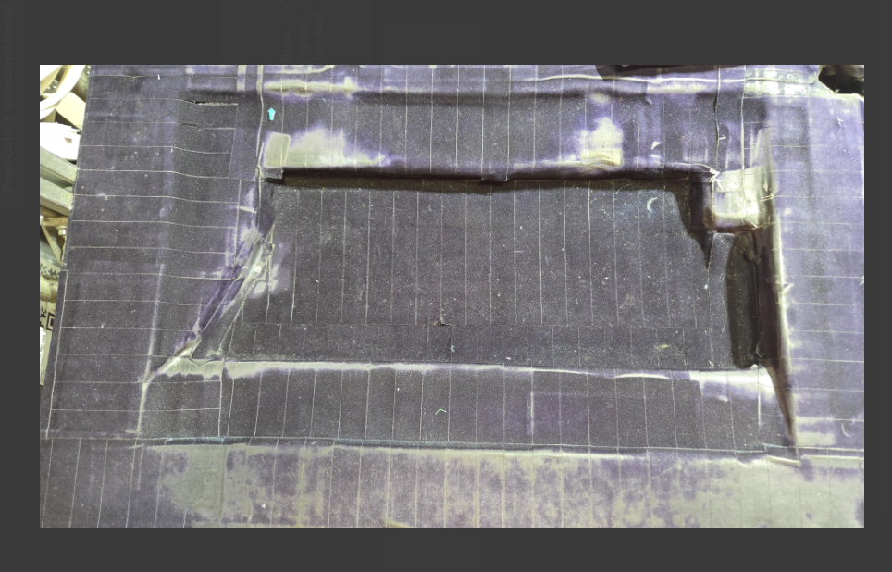
SHOP: Model-3- GA-3 Project Name: Laser Protection Bracket Design
Status: Completed
BEFORE
AFTER
Objective
Sub optimal ergonomic design of workstation causing fatigue
Benefits
Mitigates ergonomic risks associated with repetitive motions.
Decreases injury incidence and delivers a combined $10,000 in annual recurring savings.
Actions | Owner | Due | Status
Design study | Shriman | 02/05 | Completed
Concept Review | Shriman | 09/05 | Completed
First Article validation | Shriman /PC Process/ GA SX / WSD | 16/05 | Completed
Buy off | Shriman/ PC Process | 23/05 | Completed
Handoff | Shriman | 06/06 | Completed
Wastes Eliminated

Slide 11

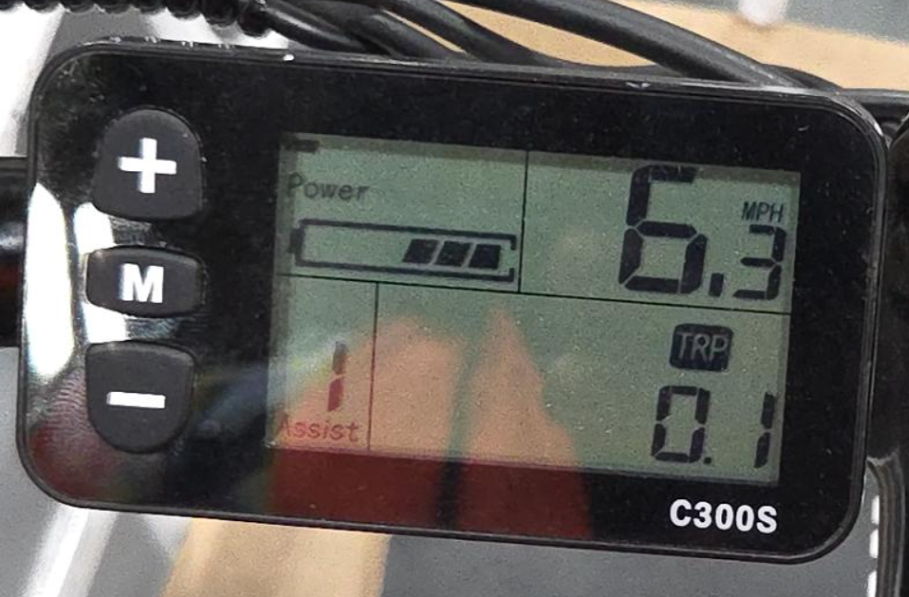
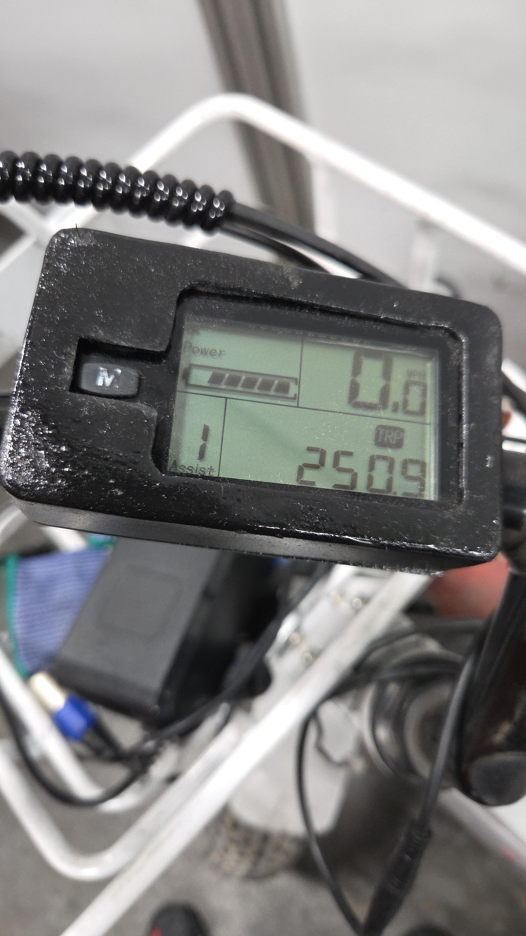
SHOP: GASX Project Name: Speed Control for trikes
Status: Completed
Objective
Factory electric trikes lacked speed controls, enabling 10-15 mph in crowded pedestrian areas, leading to speeding, near-misses, collisions, injuries, vibration strain, noise, staff unease, and disruptions violating the 5-mph limit.
This caused major waste/loss in safety (accidents, injuries, medical costs, downtime, liabilities) & operational disruptions.
Solution: Disable thumb throttle via wire removal to eliminate acceleration; add A36 fabricated screen guard to lock PAS at level 1 (~6 mph cap)
Benefits?
Enhanced safety: Fewer collisions and injuries via controlled speeds.
Better efficiency: Steady, predictable trike use; reduced component wear.
Lower costs: Less maintenance and repairs.
Improved compliance: Safer environment with accountability through training and overrides.

Slide 12





What I Bring & What I Seek
Data-driven Problem-Solving
Key Accomplishments
Mitigated Critical Safety and Downtime Risks via Automation and Process Optimization.
Achieved $26,000 in Cost Savings Through Targeted Design Improvements
Reduced Fleet Robot Setup Time, Ensuring Scalable and Future-Proof Operations with projected savings of 15 headcount.
Designed & programmed pedestrian detection for enhancing workplace safety to be installed on PIVs.
Designed and implemented Automated manual path planning process for mobile robots with reduction in time complexity by 83%.
Proactive communication
Knowledge Across Diverse Domains
Leadership-ready Experience
Solution-focused
Seeking Full-time Roles from Aug 2026 : Integration Engineer, Mobile Robotics ,Equipment Engineer, Controls Engineer, Systems Engineer
Notes:
So, as you can see, what I'm most proud of is the sheer breadth of impact I was able to deliver in the past 3 months, I bring in Problem solving, Proactive communication, and flexible to adapt to multiple domains. Also, I have professional work experience of 2 years before pursuing my masters.
in the future, I am looking for summer internships and Full-time opportunities and I would be graduating at the end of December 2026.

Slide 13
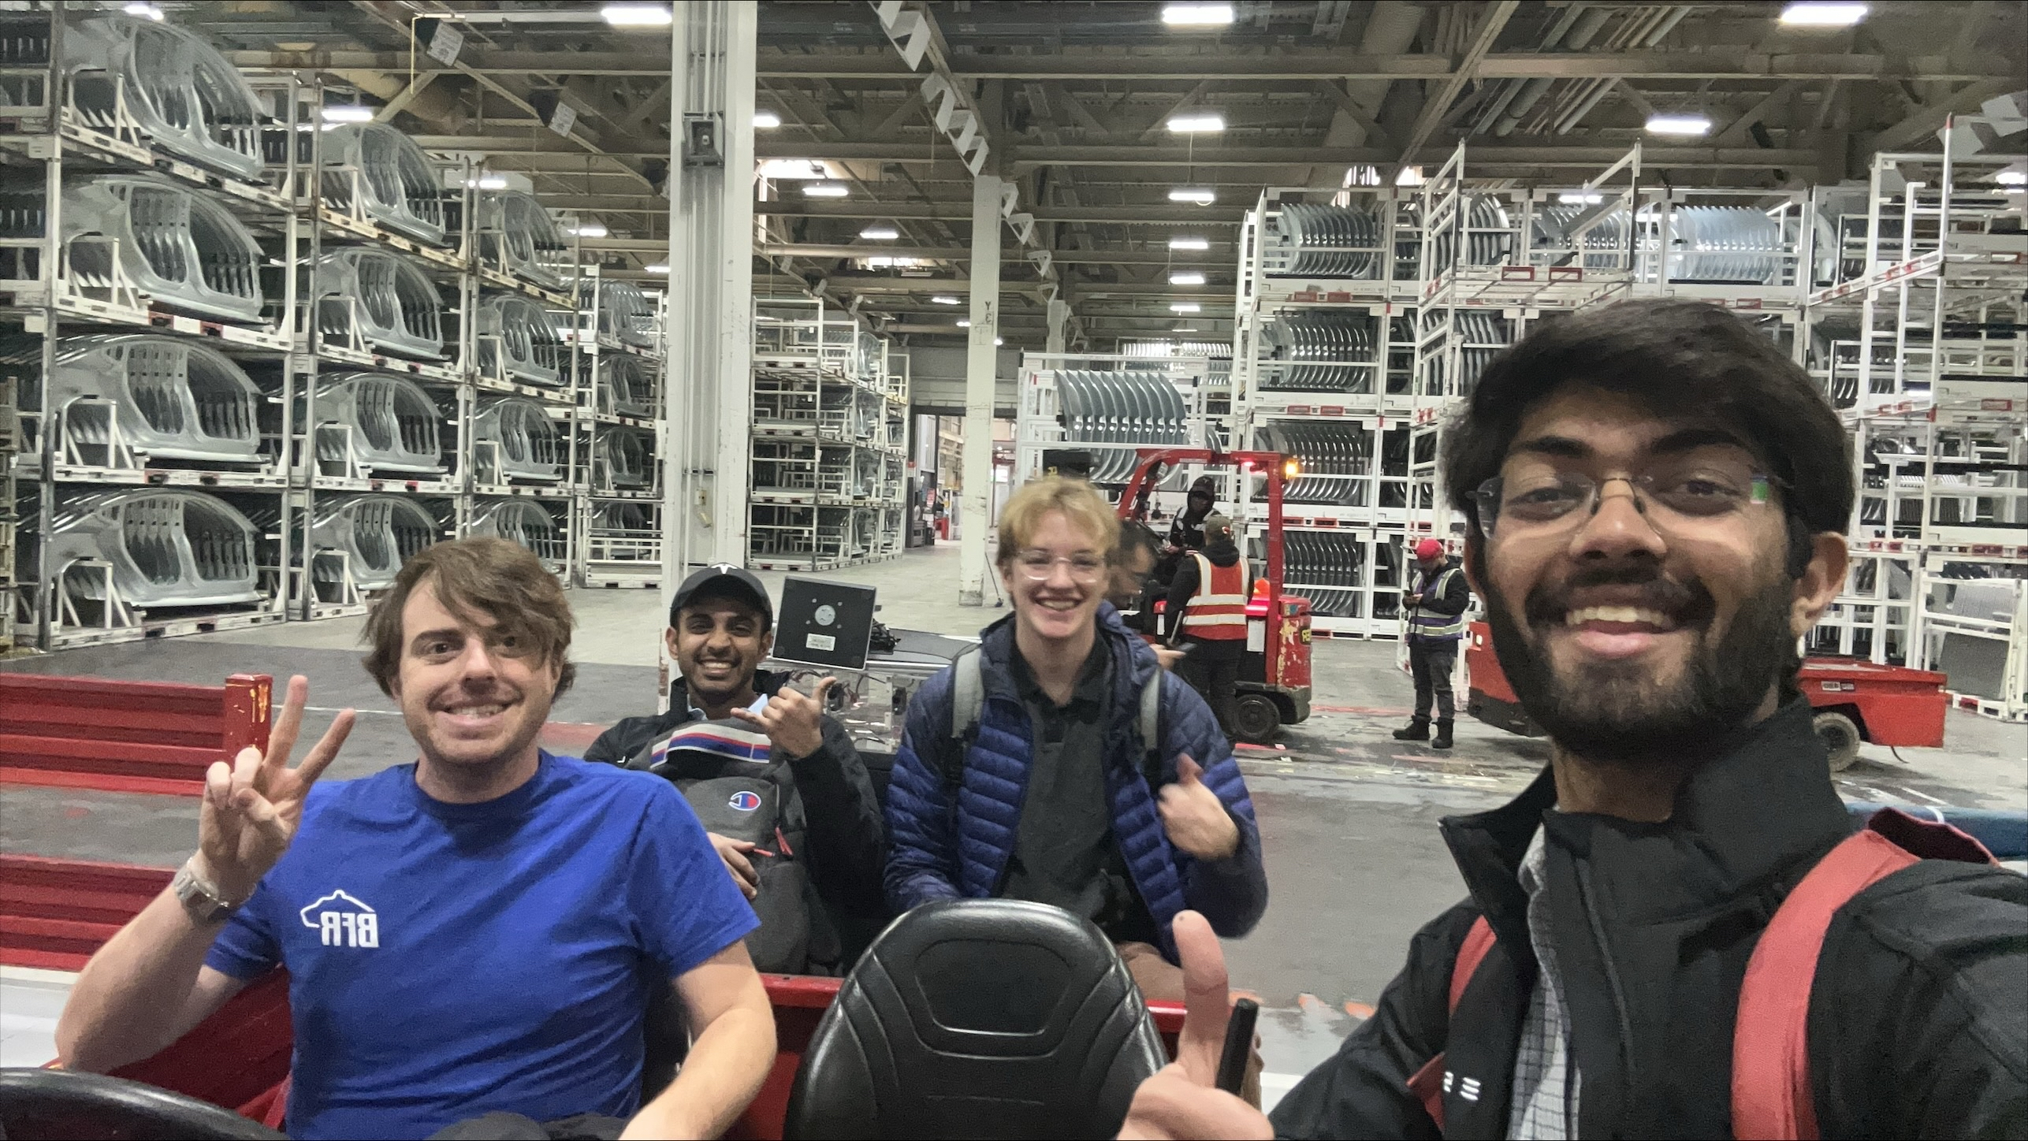
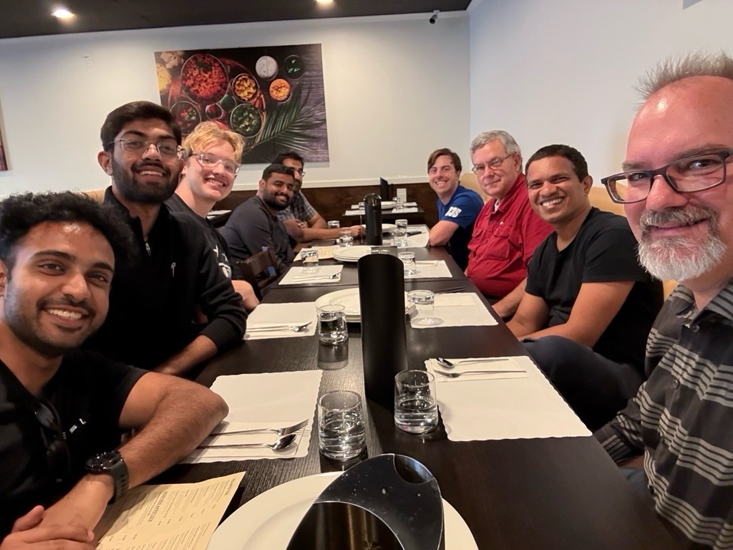
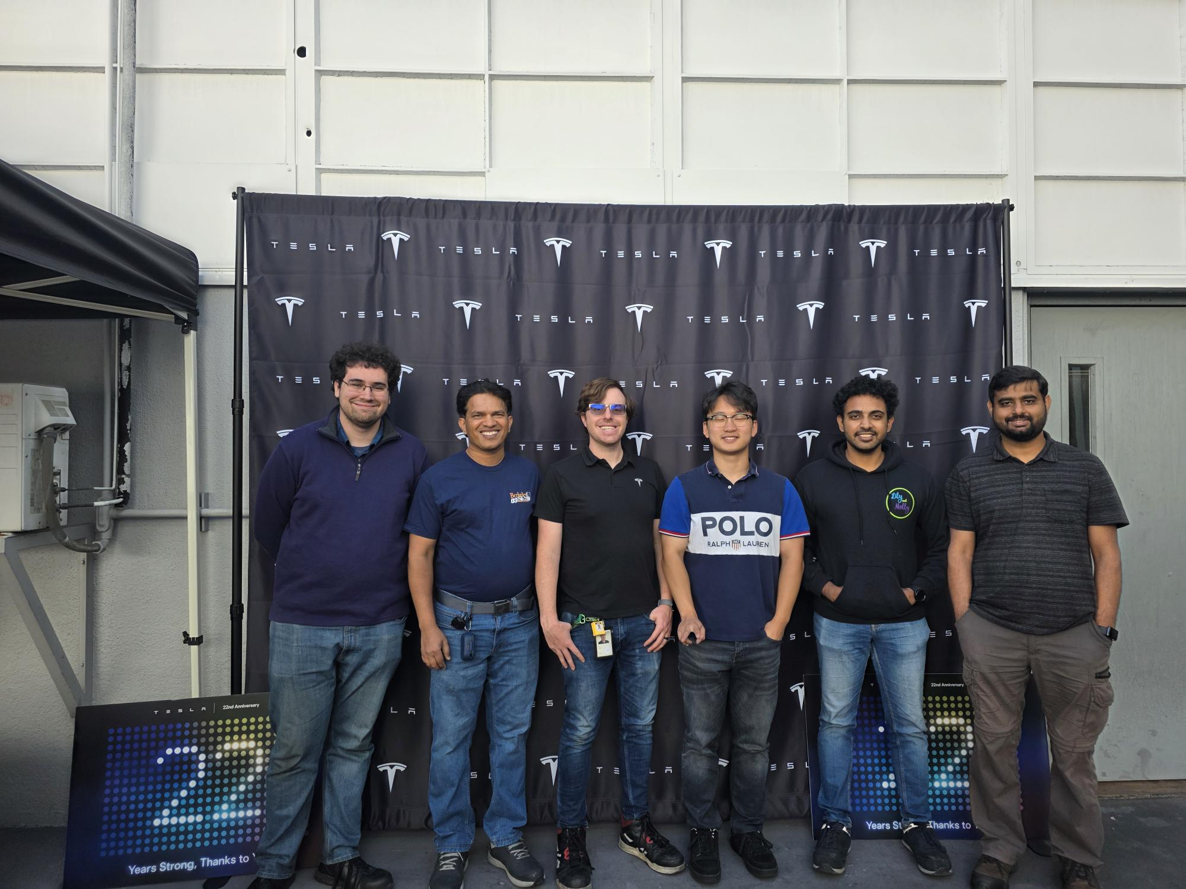
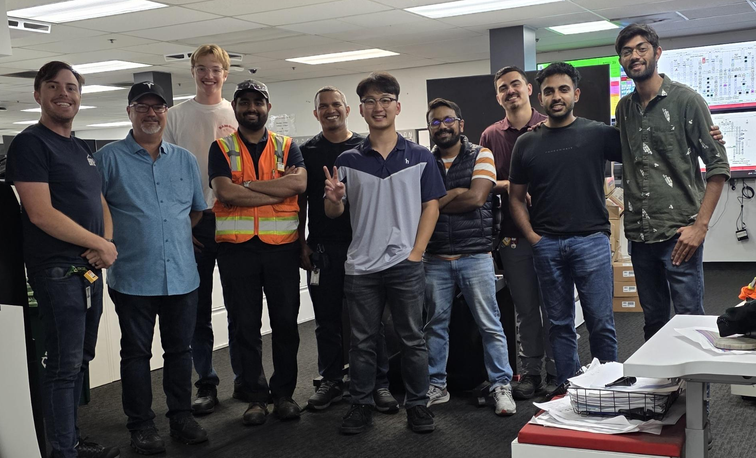
T H A N K Y O U
Looking for Full- time Roles – Aug 2026...
Notes:
To conclude , I would love to give shoutout to my current mentors Awadhut and Maaz and my team for providing me the platform to work on these wonderful projects. Thanks to Shravani and her Overmind team as well for giving me the opportunity to collaborate and finally thanks to all of you guys for patiently listening to me and hope it wasn’t a lullaby to sleep!
I believe I bring the deep-down technical depth as well as the cross-domain breadth with versatility of multiple domain that is required for this role and look forward to meet the team in person. And here are my links to my LinkedIn , my resume and GitHub Tesla profile where I have stored my code. Thanks!

Slide 14





SHOP: Across Tesla Project Name: In house Pedestrian Detection System – Project S.E.N.T.I.N.E.L
Safety Enhanced Neural Tracking for Industrial Navigation & Environment Learning
Status: In Progress
Actions
Benefits
Complete stand-alone solution that can be installed on all PIVs provide immediate increase in operator safety in the factory.
Reduction of equipment related safety incidents in the factory
Control over both hardware and software layers for future improvements.
Programmed the in-house pedestrian detection system with Deep learning and Computer vision.
PRODUCTIVITY
QUALITY
COST
DELIVERY
SAFETY
MORALE
Designed BOM for in house product design ~ $2000 per system
Containerized for scalable deployment.
Implemented Dashboard for Realtime monitoring of live camera feed of PIVs
Documentation for scalable deployment across multiple PIVs

Slide 15
SHOP: Model-3 General Assy. Project Name: Automated IP Conveyance to GA-Lineside
Status: In Progress
Why?
The Problem
OPERATIONAL CHALLENGES
High dependency on manual forklifts lead to material flow inconsistency
Frequent delays due to operator non-availability and shift timing
SAFETY CHALLENGES
Human–forklift interaction zones cause potential near-miss incidents
Congested aisles increasing collision risk
SCALABILITY CHALLENGES
Manual operations don’t scale with production ramp-up -> Current UPH design of 55 UPH not being catered with existing forklifts
Notes:
The motive of the entire project is to move the instrument panel of the model-3 car from the Dock conveyor .... All the way into the transfer stand at GA side below the mezzanine which is then put on the AGVs to transfer it to GA line. The current operation uses 4 forklifts or sometimes 5 to 6 depending on the UPH the line is running in and these causes line performance losses due material availability , also we all know the risk of operating forklifts in human interaction zones, and it leads to lot of near miss incidents and finally ,the current setup can cater only 45 to 50 UPH while the GA line requirement is 55 UPH as per the factory design.

Slide 16
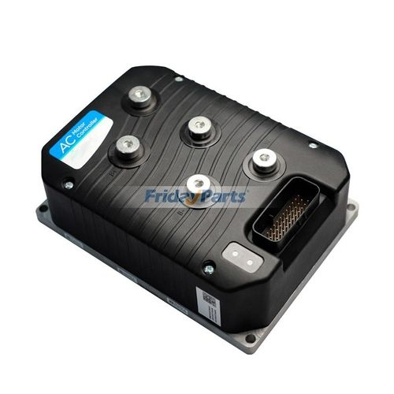
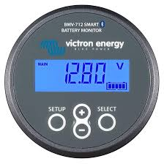
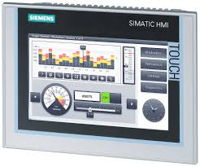
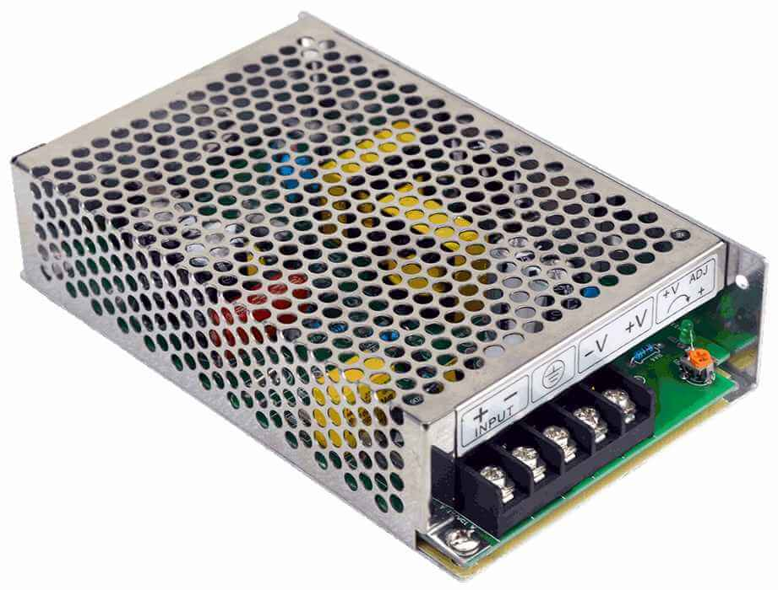
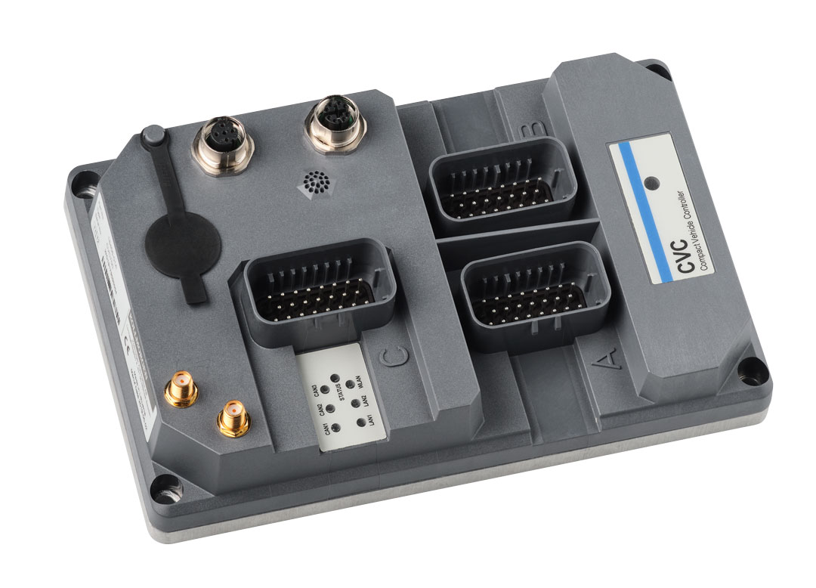
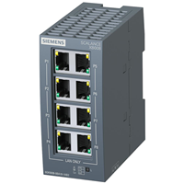
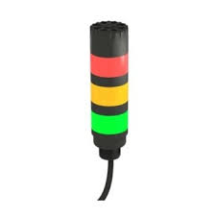
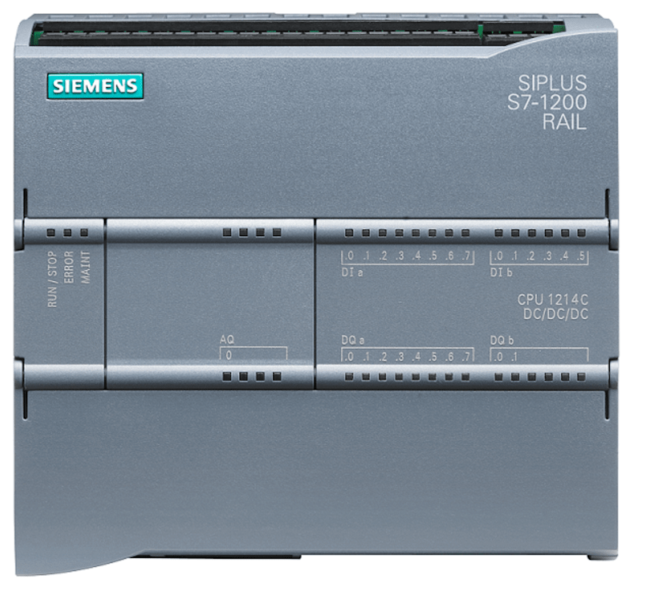
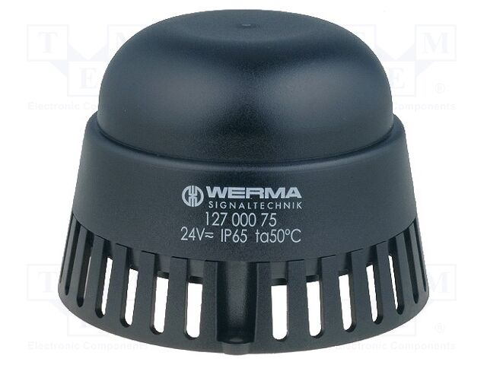

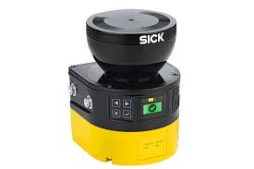
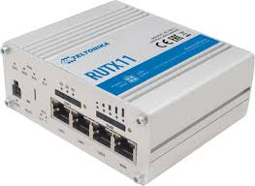
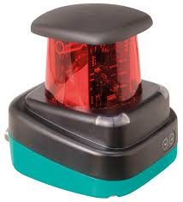
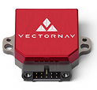
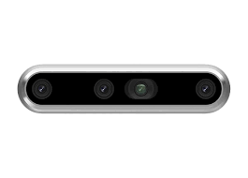
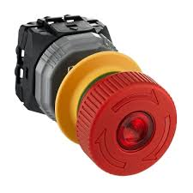
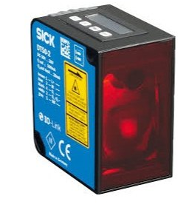
Electrical design- CVC700 AMR
USB
EtherCAT
TwinSAFE
Ethernet
CAN
24VDC
24V Power supply
Curtis Forklift Controller
Victron BMV-712 Battery indicator
Siemens SIMATIC 6AV2123 HMI
KollMorgen CVC 700
Siemens S7-1200 PLC
Siemens SCS36 Ethernet Switch
Werma 1200075 buzzer
Banner TL50 Tower Lights
Samsung NVMe SSD
SICK Microscan3
SICK Microscan3
Pepperl+Fuchs OMD30M LiDAR
Teltonika RUTX11 5G Router
Intel RealSense D455
Vector NAV VN-100
IMU
SICK Distance sensor DT50
Schneider Electric A40 Emergency trigger

